Slide 1

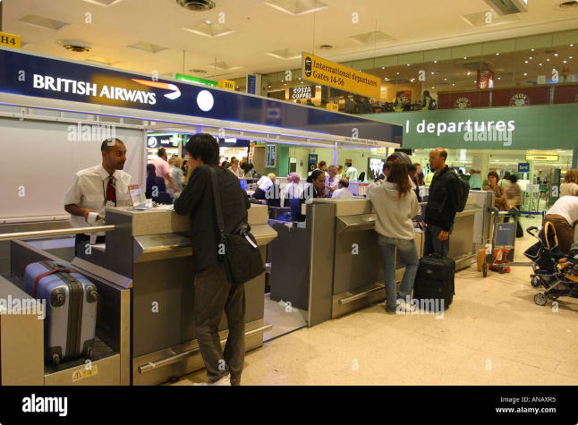
Airline Reservation System Overview
An airline reservation system is a complex software platform that streamlines the process of booking, managing, and tracking air travel. It integrates with various internal systems and external providers to ensure seamless operations for airlines and passengers.

Slide 2

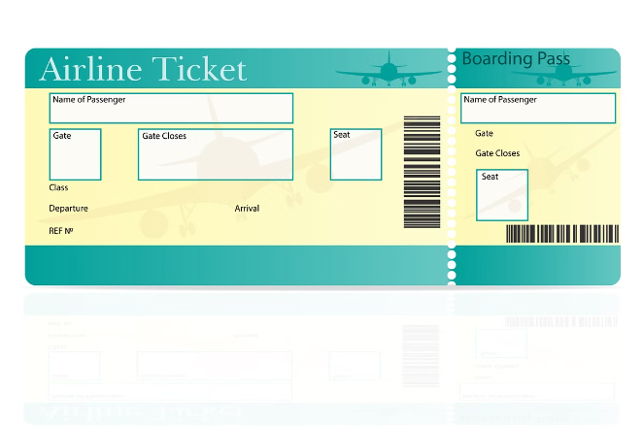
Booking and Ticketing Functionality
1
Search and Availability
2
Booking and Payment
Passengers can search for flights based on criteria such as origin, destination, date, and budget. The system displays available flights with real-time pricing and seat availability.
Passengers can select their preferred flight and make online bookings. The system integrates with payment gateways to process secure transactions and issue electronic tickets.
3
Confirmation and Management
4
Special Services
Upon successful booking, passengers receive confirmation emails with booking details and itinerary. They can also manage their bookings online, including seat selection and baggage allowance.
The system enables passengers to request special services, such as wheelchair assistance, pre-ordered meals, or pet transportation.

Slide 3
Passenger Management and Check-in
Passenger Profiles
Check-in Options
Security and Gate Information
The system stores passenger information, including contact details, travel history, and loyalty program membership. Passengers can access and manage their profiles online.
Passengers can check in online, at airport kiosks, or at dedicated check-in counters. The system manages seat assignments, baggage tags, and boarding passes.
Passengers receive real-time updates on security procedures, gate information, and flight delays through the system.

Slide 4

Flight and Schedule Management
1
2
3
Flight Planning
Route Optimization
Real-time Tracking
Airlines use the system to plan and manage flight schedules, taking into account factors such as aircraft availability, crew assignments, and fuel efficiency.
The system optimizes flight routes and connections to ensure timely and efficient operations. It considers factors like weather conditions and air traffic control.
The system tracks flights in real time, providing updates on flight status, estimated arrival and departure times, and any potential delays or disruptions.

Slide 5

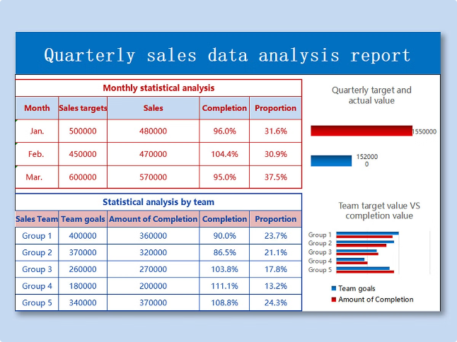
Reporting and Analytics
Sales and Revenue
Track booking revenue, ticket prices, and sales trends.
Passenger Demographics
Analyze passenger profiles, travel patterns, and preferences.
Operational Performance
Monitor flight punctuality, on-time performance, and resource utilization.
Customer Satisfaction
Gather feedback, measure customer satisfaction, and identify areas for improvement.

